Slide 1
Software Development
Incremental development method
Hello, world!
Norman
(Yubo Zhi)

Slide 2
Incremental development method
Split entire program into small parts
Perhaps continually split them into smaller parts
Complete basic data structures & functions first
Build a further small part every time, make sure it works as required
Continually build & combine parts, until finish the program
Perhaps some extensions

Slide 3
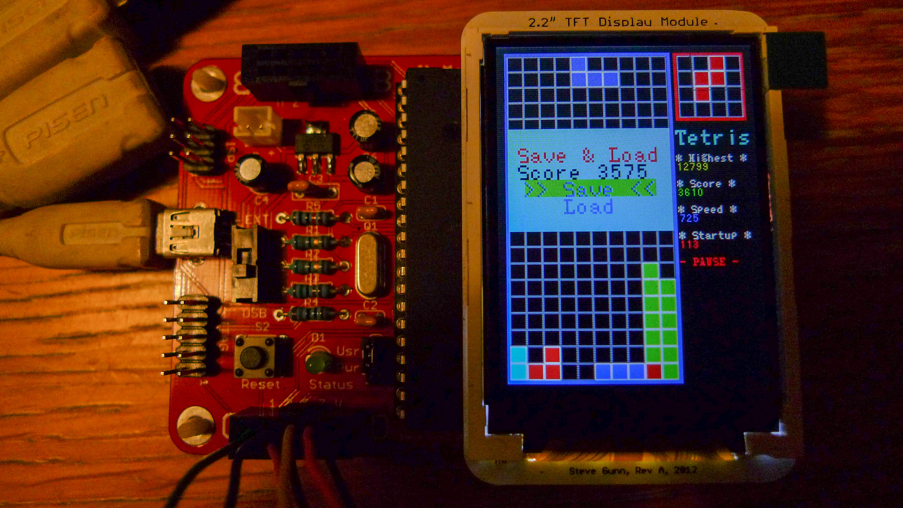
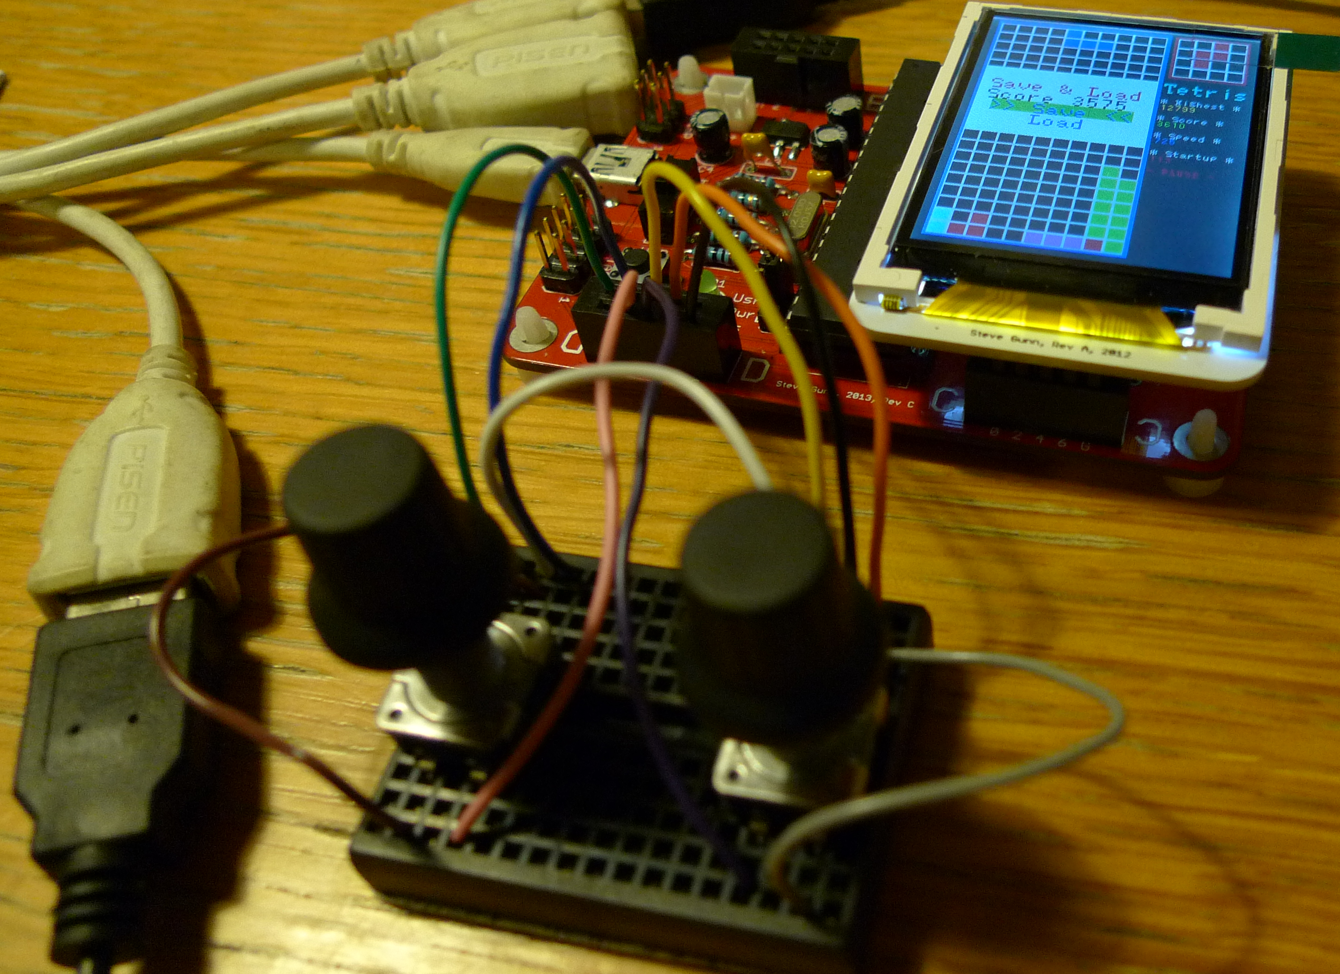
TETRIS!

Slide 4
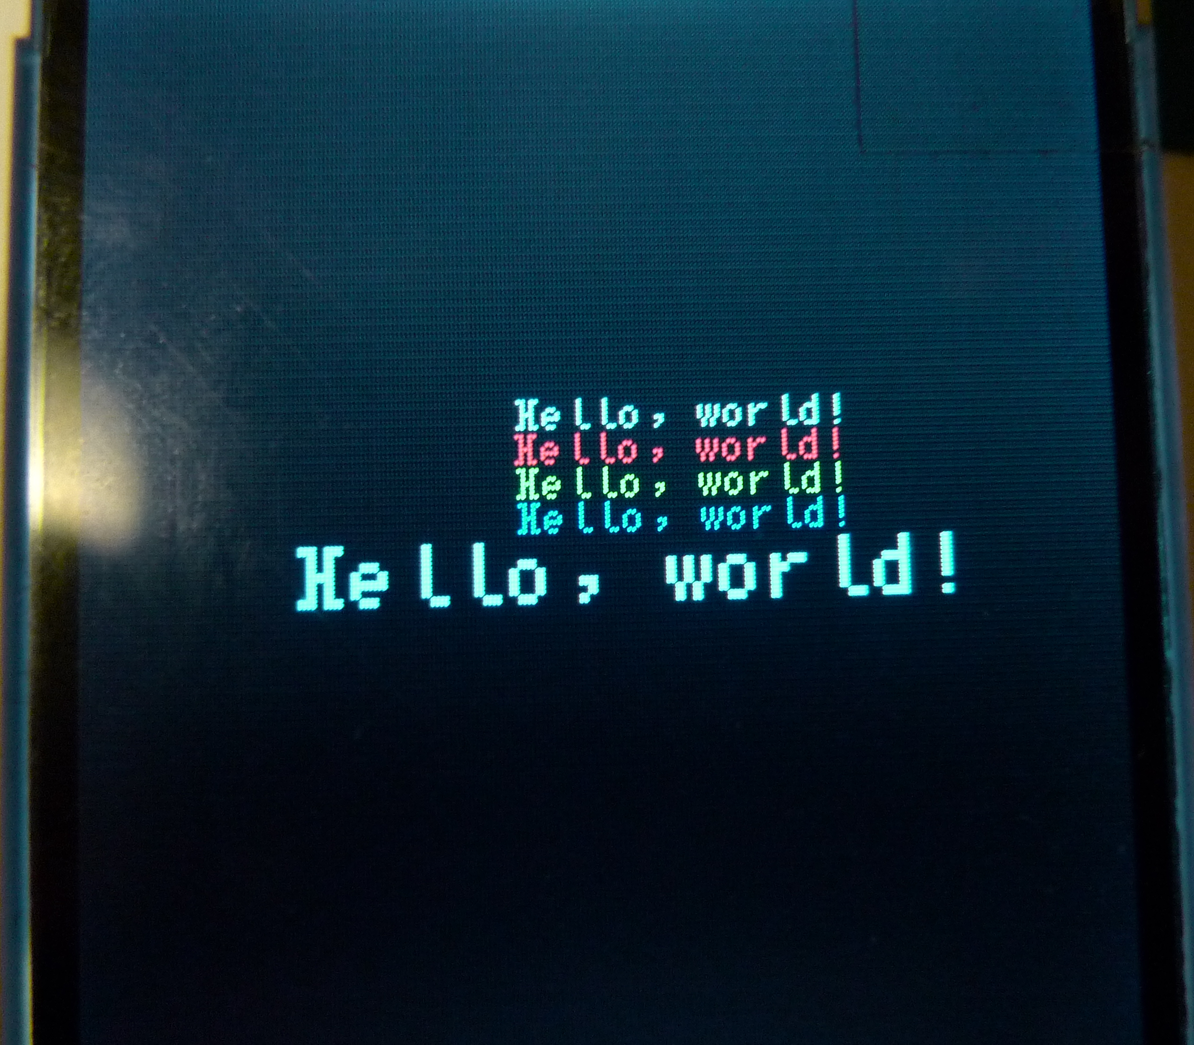
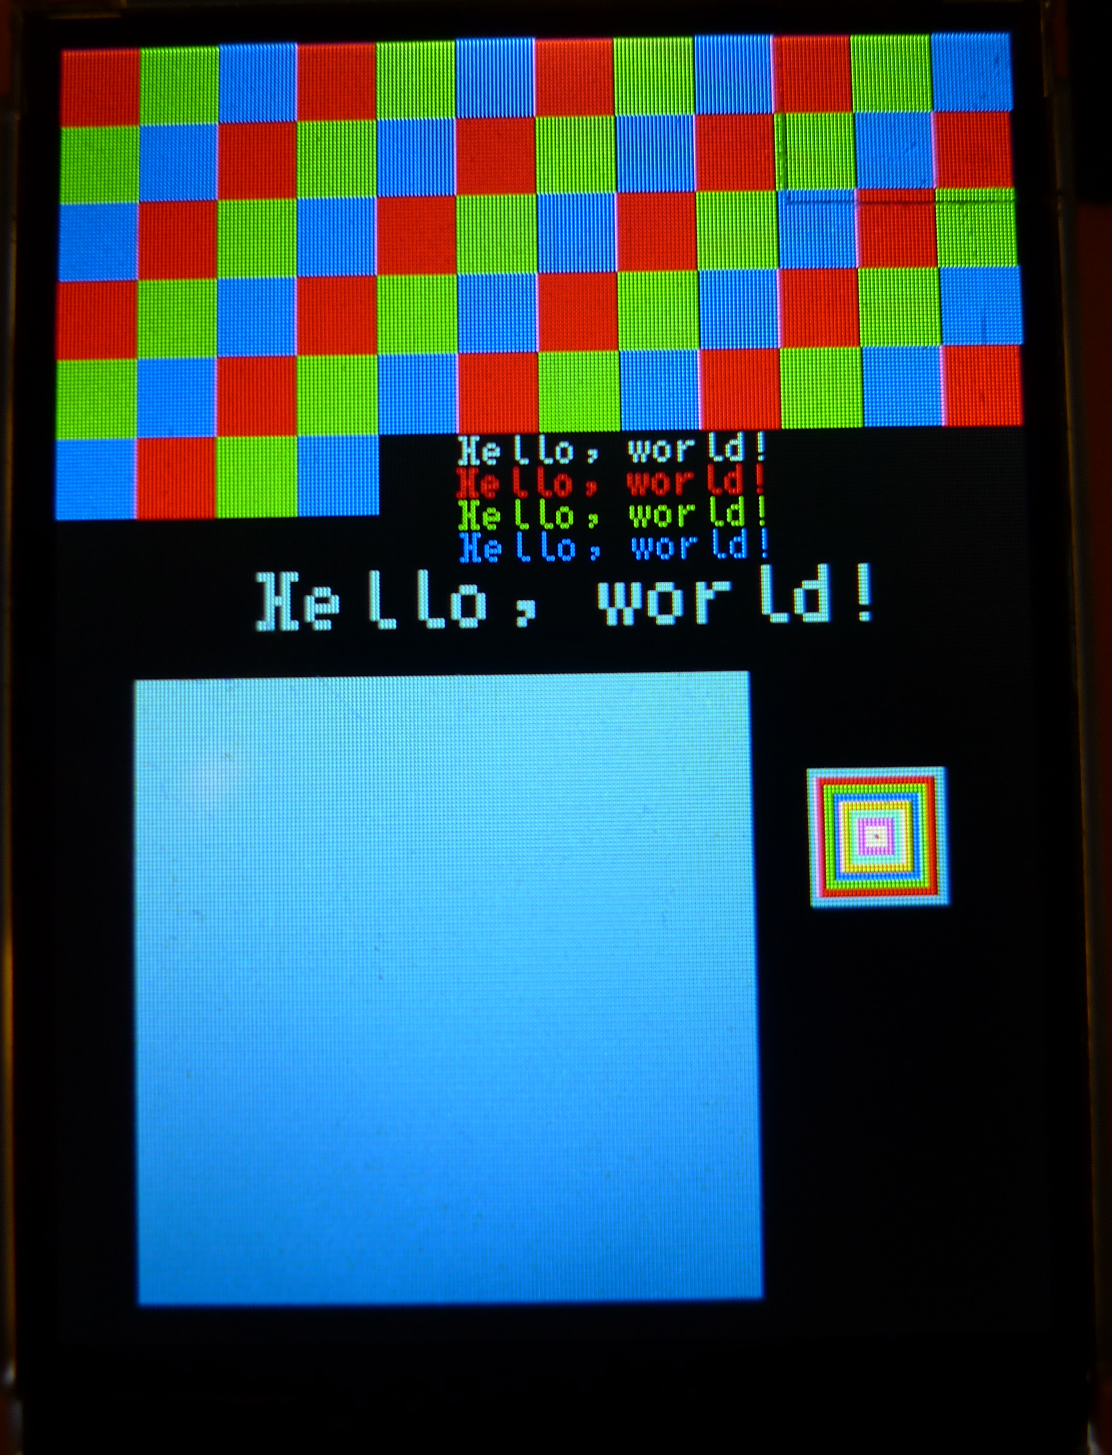
Initialise the TFT, basic drawing functions

Slide 5
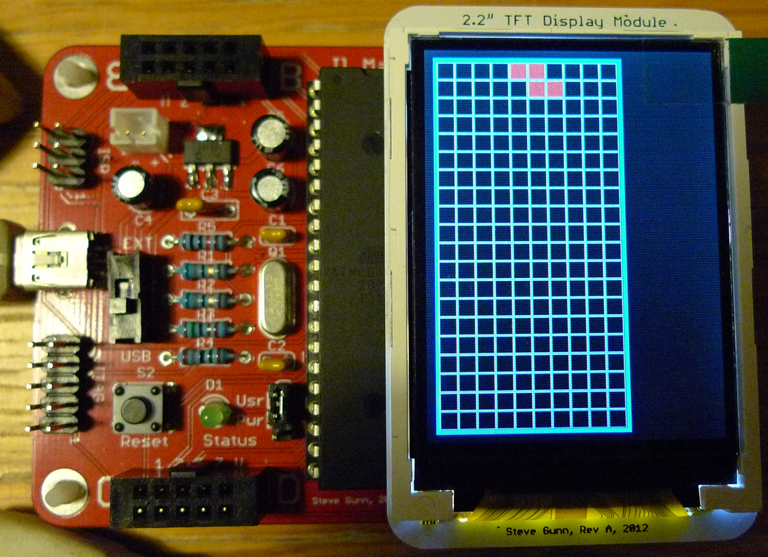
Board display, random generation function

Slide 6
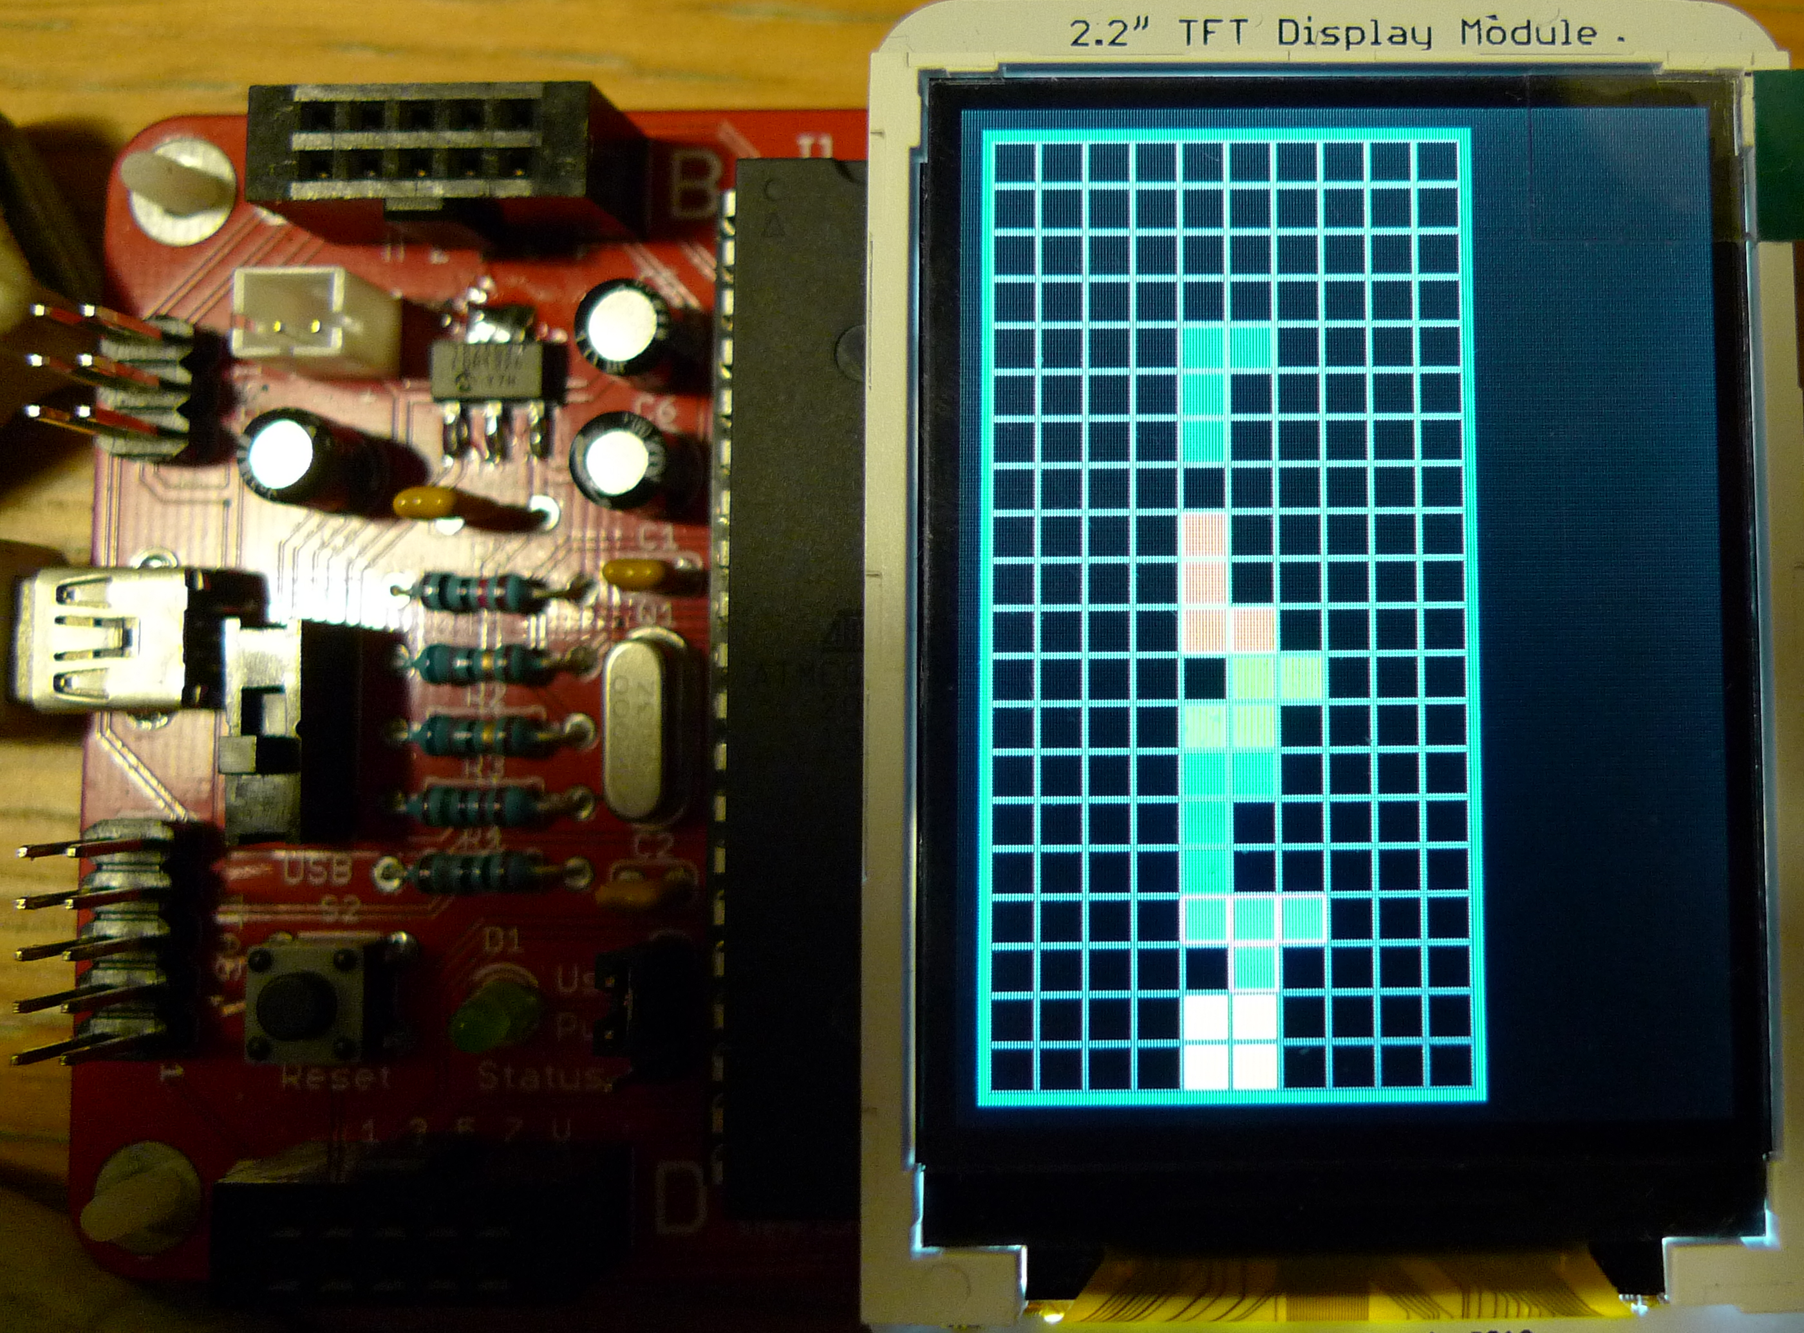
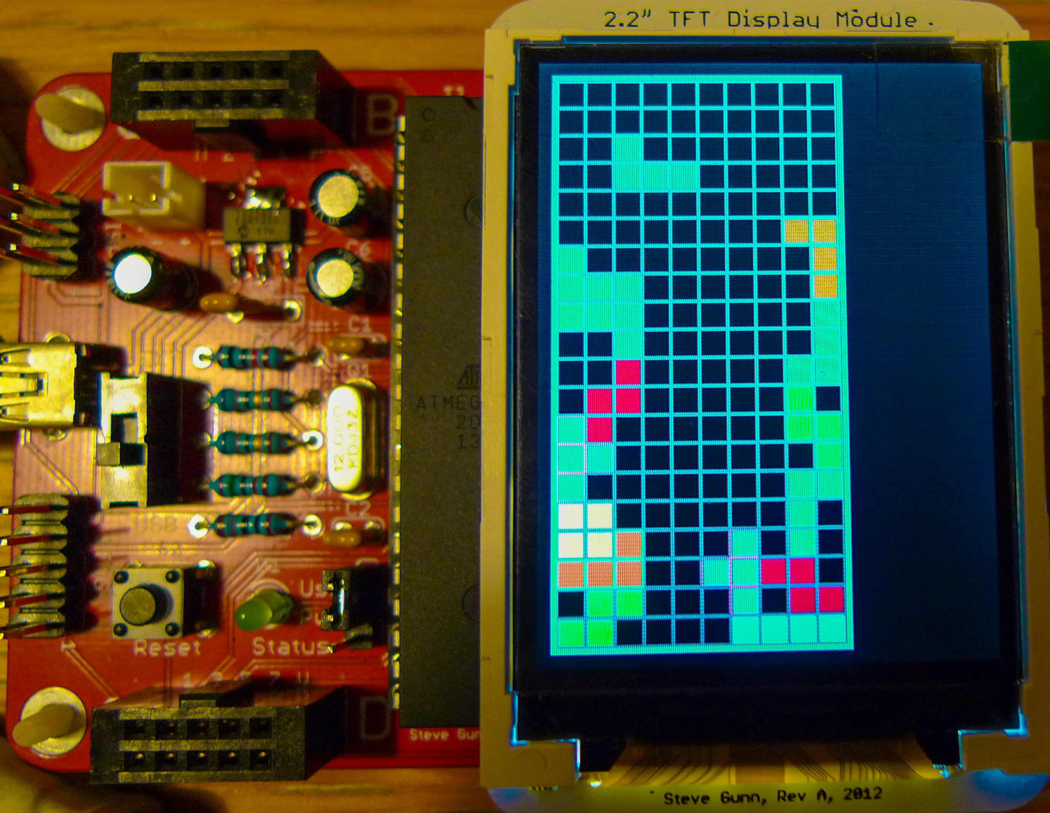
Drop & place function, move function

Slide 7
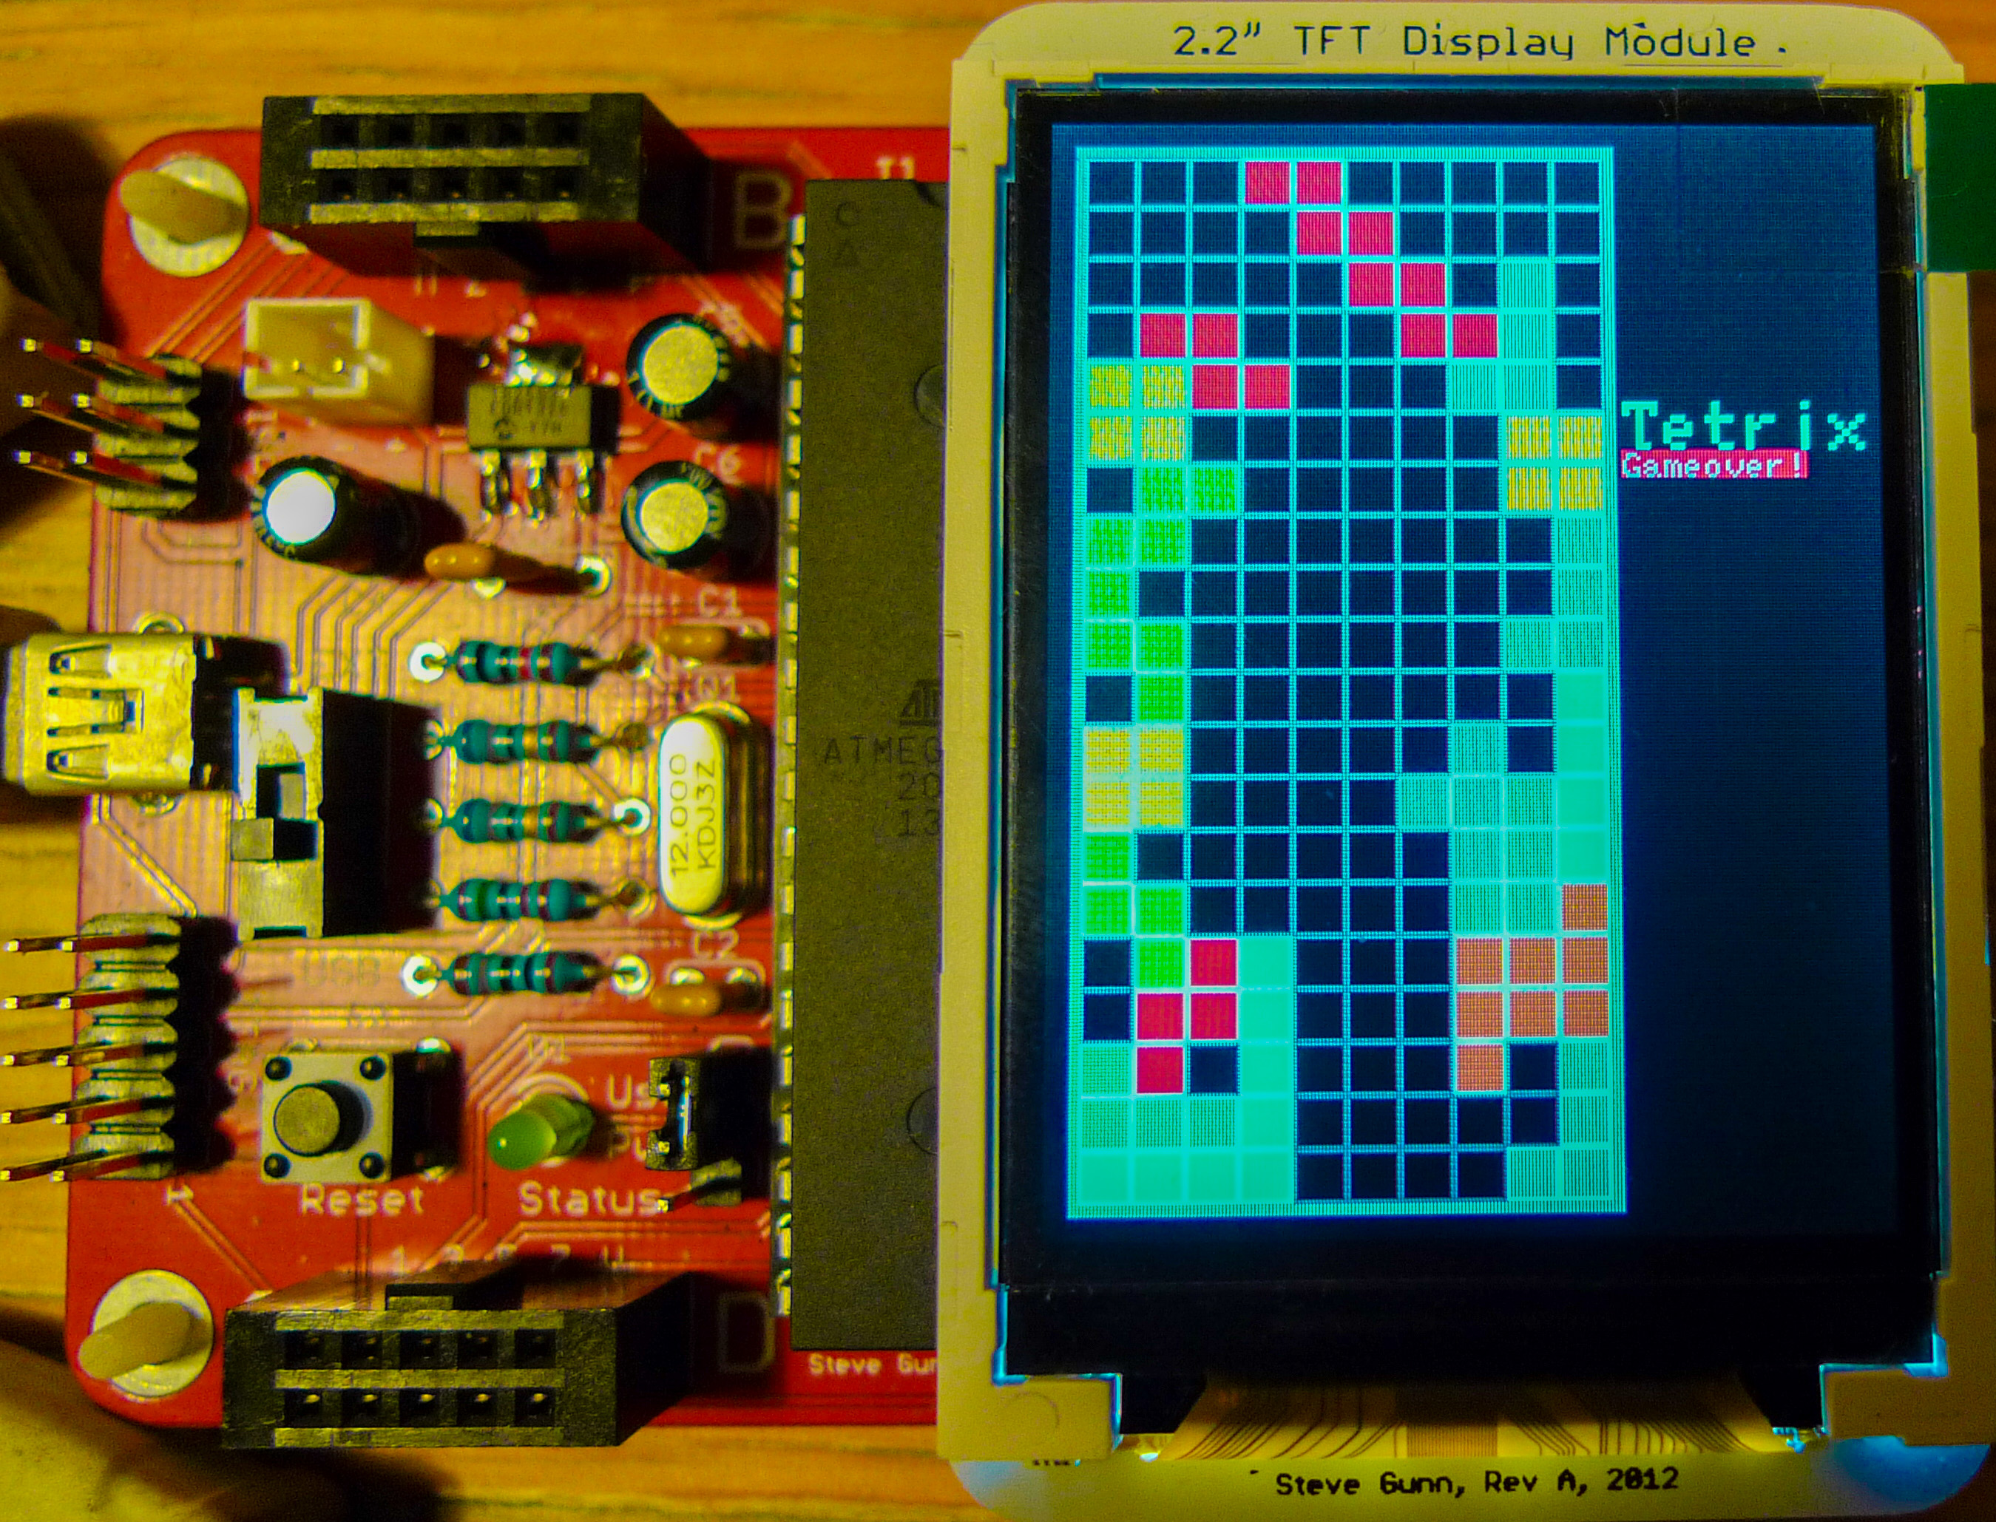
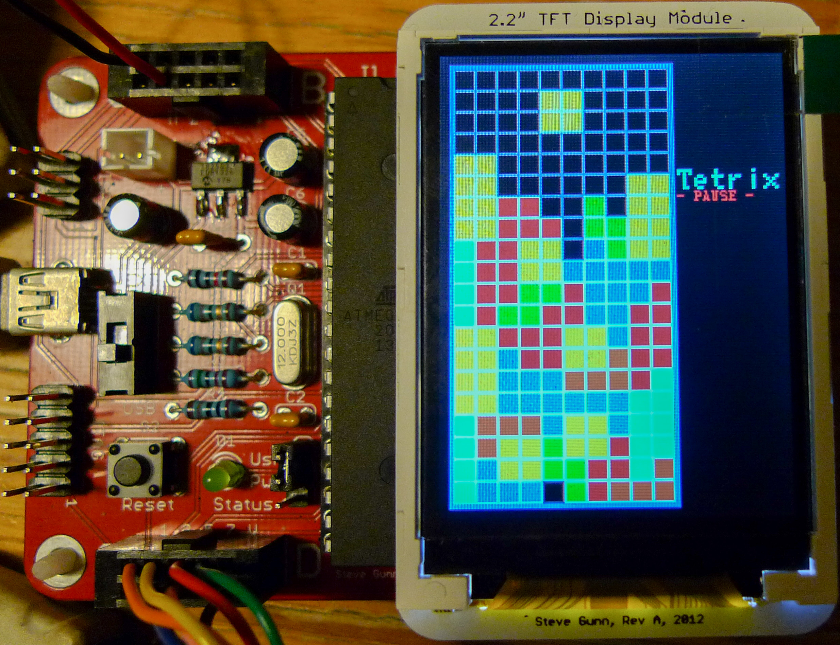
Game over detection, keypad control & pause

Slide 8
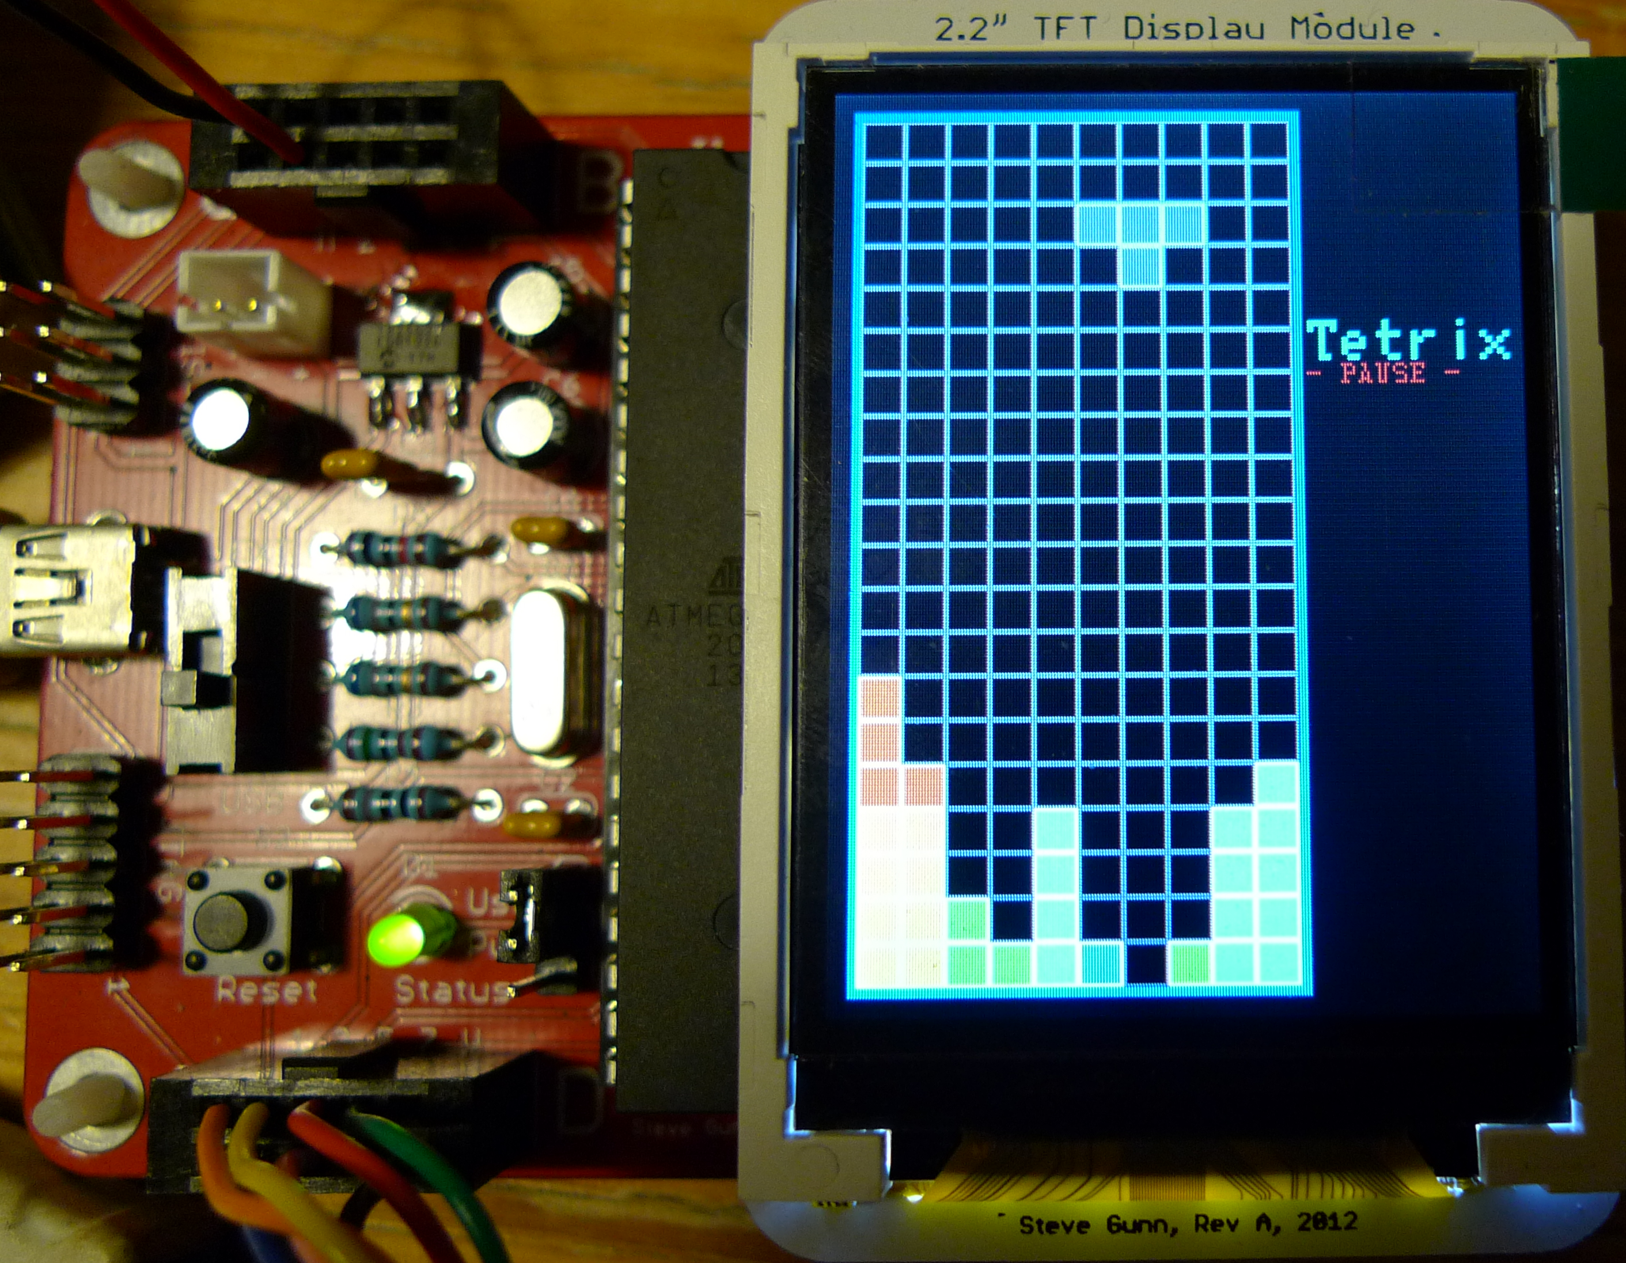
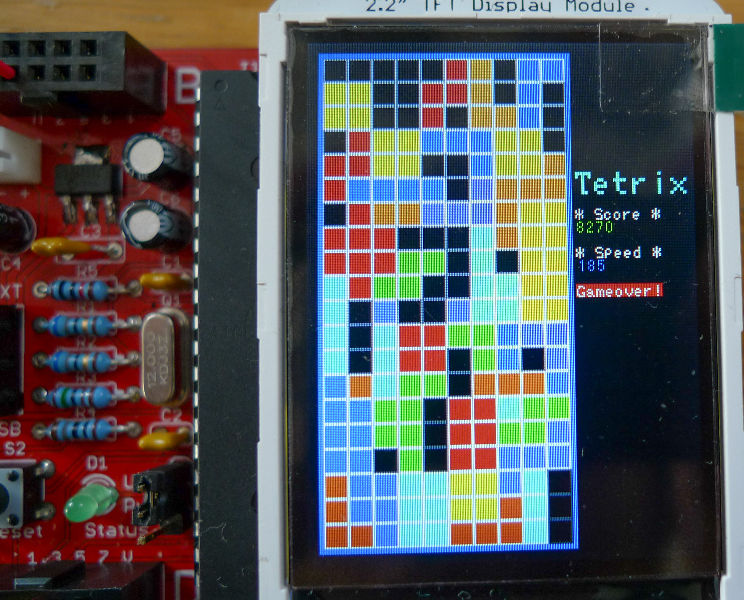
Line eliminate, score & speed display

Slide 9
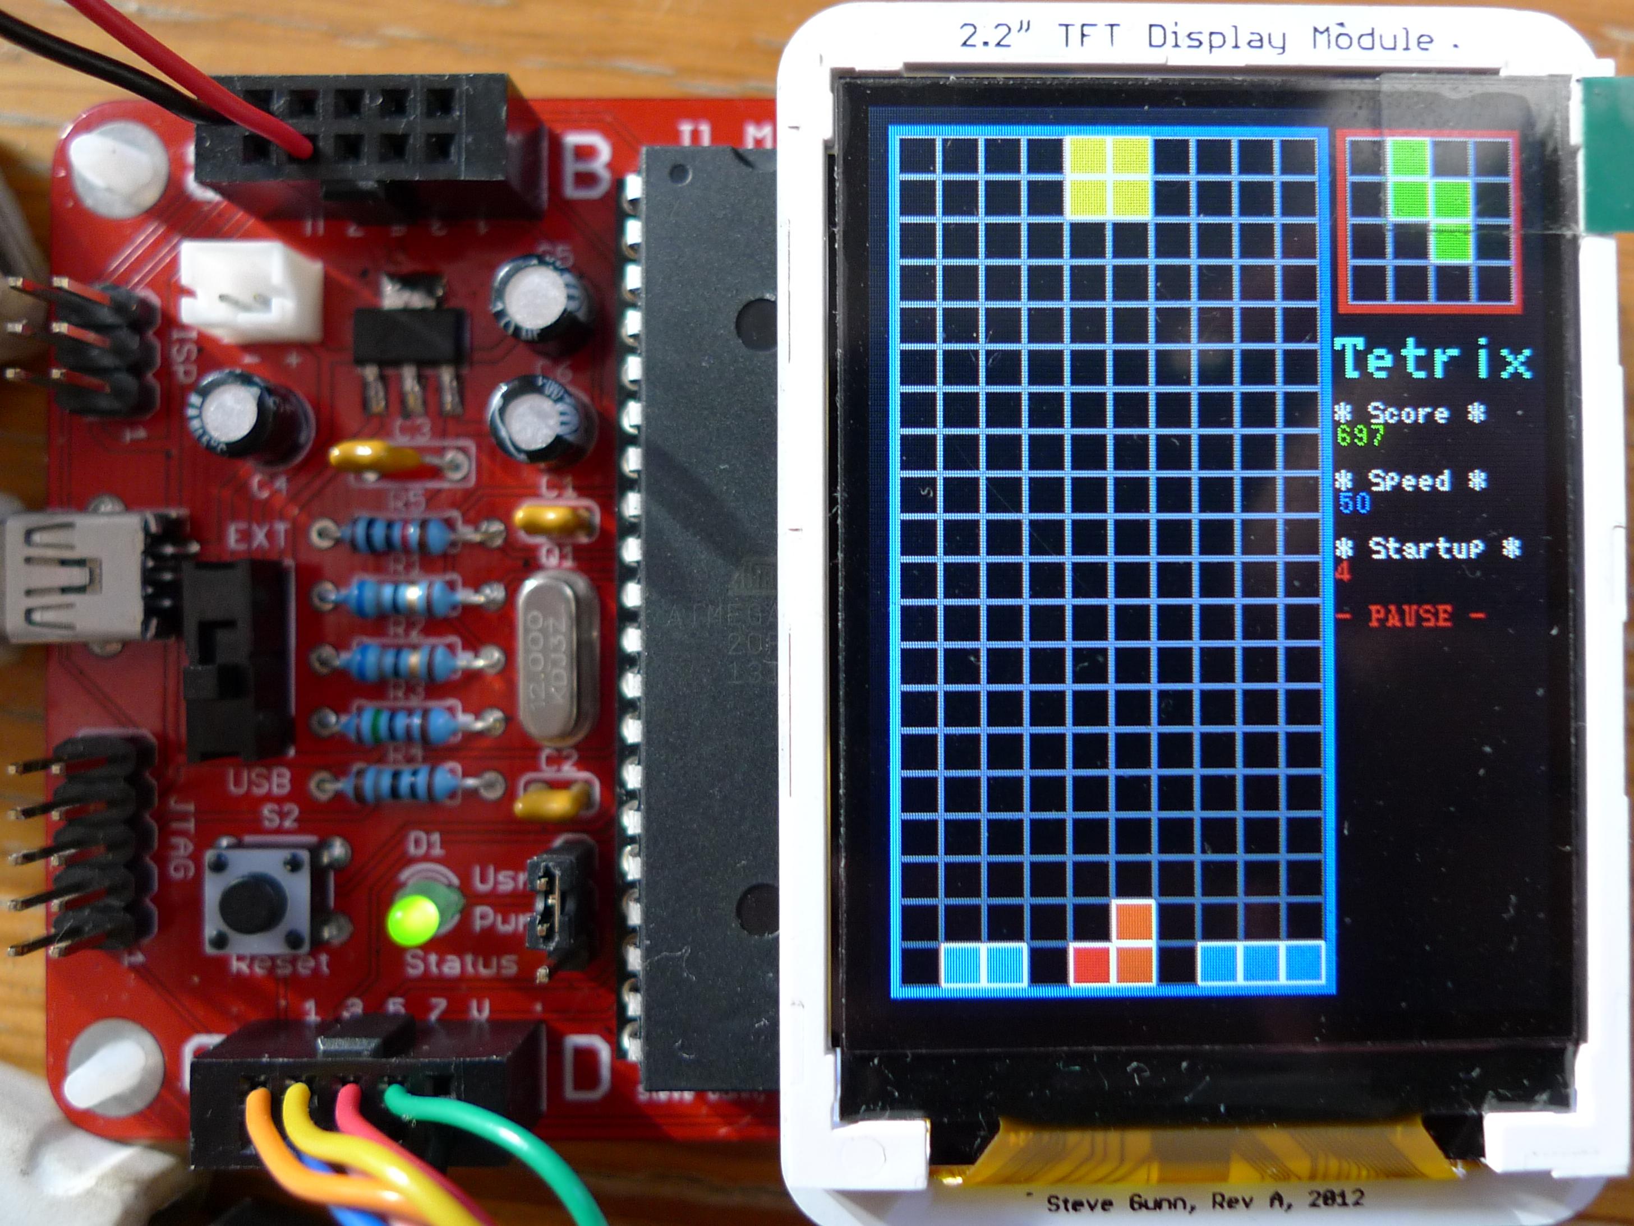
Extended: next unit, high score, save & load

Slide 10
Incremental development
Advantages:
Small parts of code is easier to write
Easy to debug
Easy to extend
Can be used for group project
Disadvantages:
Difficult to change basic structure

Slide 11
Thank you!
Reference: http://en.wikipedia.org/wiki/Software_development_methodology
Source code: https://github.com/zhiyb/TFT/tree/Tetris
Questions?

